Slide 1
The Cog Project: Building a Humanoid Robot
Rodney A. Brooks, Cynthia Breazeal, Matthew Marjanovic, Brian Scassellati, Matthew M. Williamson
Presented by Edward Venator

Slide 2
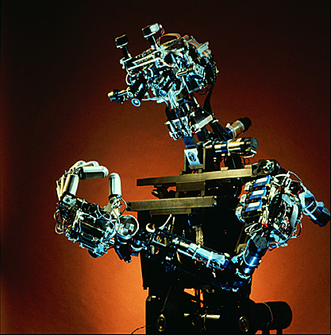
Introduction
Cog: a Humanoid Robot
Two goals
Build a general purpose humanoid robot
Gain understanding of human cognition
Uncovered new problems and solutions in control theory, robotics, and AI.
Draws on many social science fields

Slide 3
Methodology

Slide 4
Methodology
Classical AI
New Methods
Monolithic internal models
Monolithic control software
General purpose processing
Not biologically plausible
Computationally intensive
Inspired by cognitive science
Four attributes
Developmental organization
Social interaction
Embodiment/physical coupling
Multimodal integration

Slide 5
False Assumptions in Classical AI
Monolithic internal models
Humans do not notice minor changes in a scene, only major changes
Humans do not store a full world model
Monolithic control
Humans with surgically split brains maintain separate but complementary control systems
Humans have multiple, independent control systems
General purpose
There are tasks that humans are good at, and computationally similar tasks that humans are bad at
Humans are more emotional than rational

Slide 6
Human Intelligence: Four Aspects
Development
Build skills incrementally
Reduces the difficulty of learning
Systems that scale autonomously
Social Interaction
Allows for human-machine interaction
Facilitates learning
Embodiment
Real (humanoid) systems are necessary for human intelligence
Offloads calculation of most physical dynamics to the real world, rather than simulating it (gravity, friction, etc)
Allows exploitation of system dynamics
Integration
Senses are not independent
One sense can benefit from information from another (e.g. Moving things make noise, allowing interaction between visual and auditory systems

Slide 7
Computation Hardware
“Brain” made of several networked processor nodes
Digital signal processors to handle visual/auditory sensor data
Each joint controlled by its own small microcontroller, which reads joint sensors and controls joint motor

Slide 8
Perception Hardware
Visual
Two articulated eyes
Each eye has a high resolution, low field-of-view camera and a low resolution, high field-of-view camera
Vestibular
Analogous to human inner ear
Gyroscopic yaw rate sensors and accelerometers
Auditory
Two ears with onmnidirectional microphones
Tactile
Array of pressure sensors on the robot’s torso
Pressure sensors on some hands
Kinesthetic
Incremental encoders on all joints
Temperature and current sensors (crude force sensing) and limit sensors on all joints except eyes
Strain gauges, absolute position sensors, and limit switches on arms

Slide 9
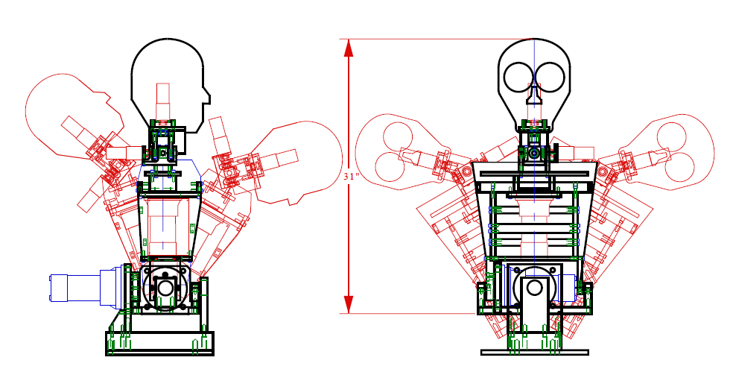
Motor Hardware
Arms
6 DOF, human proportions
Series elastic actuators
Virtual spring damper system; moved by changing equilibrium position
3 DOF Neck
2 DOF Torso
1 DOF Spine Twist

Slide 10
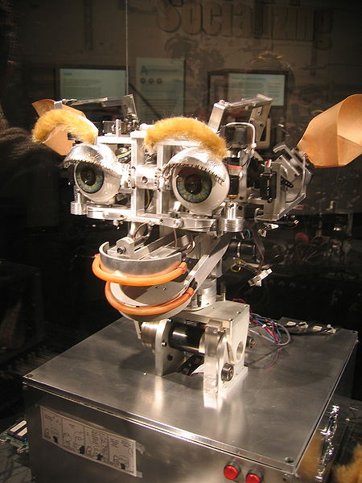
Development Hardware
Emotive Response Platform (Kismet)
Facial features (eyelids, eyebrows, mouth)
Able to show 9 expressions linked to “emotions”
Vision Platform
Color Cameras
Vision-auditory platform
Simplified vision system

Slide 11
Long-Term Projects

Slide 12
Joint Attention
Definition: The recognition of others as agents with their own beliefs, desires, and perceptions
Necessary for social interaction
Necessary for learning using normal social interaction
Requires coordination of many systems and processes

Slide 13
Infant/Caretaker Social Interaction
Two-way interaction with a caretaker
Caretaker interacts with infant/robot
Infant/robot responds emotionally
Caretaker modifies behavior as a result of infant/robot’s reaction
Should be possible for robot to learn how to influence caretaker with emotional responses

Slide 14
Dynamic Arm Motion
Kinematic solutions to joint position/force are computationally expensive
Instead, exploit mechanical characteristics of the robot’s body
Independent controllers at each joint, couple through the physical body of the robot
Robust to perturbation, no need for accurate calibration, computationally simple

Slide 15
Multi-Modal Coordination
Need a facility for combining skills
Combine sensory inputs
Synergistic interaction of motor systems
“Sensory tuning” i.e. a motor system is used to increase the effectiveness of a sensory system
Requires performance measures of sensorimotor systems (sensory confidence measures, motor accuracy and effort measures). These are easy to determine.
Requires segmentation of data stream into “events” to allow correlation of events. This is hard to do.

Slide 16
Current Tasks

Slide 17

Visual-Motor Routines
Saccades
Quick motion to center an object in the visual area
Saccade function $S:\left(x,e\right)→∆e$ maps target and eye position to change in eye position.
Target position is determined by computer vision. Eye position is measured from encoders.
Saccade function created by unsupervised learning
Smooth-Pursuit Tracking
Keeps moving object centered in visual area
Uses computer vision to determine object speed.
Moves eyes to match
Binocular Vergence (point both eyes at the same target)
Vestibular-ocular Reflex (VOR) and Opto-kinetic Reflex (OKN)
VOR stabilizes the eye during rapid head movement using the vestibular system, but is prone to drift over time
OKN stabilizes the eye during slow head movement using optical flow, and can be used to train VOR gains and cancel VOR drift

Slide 18

Eye-Neck Orientation
Animals turn their heads to center their eyes, which maximizes the range of subsequent eye motions
Requires a mapping $N:(n,e)→∆n$from neck and eye position onto change in neck position. This is a linear mapping.
Using VOR to counter-rotate eyes during neck motion can result in instability due to vibration.
In order to keep the eyes stable during neck motion, counter-rotate them with the same (scaled) velocity commands as the neck.

Slide 19
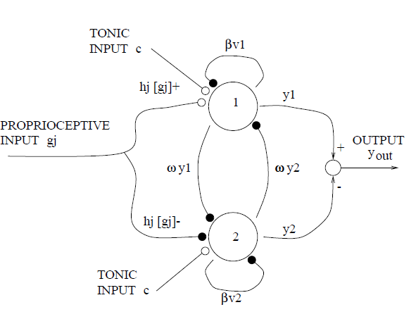

Dynamic Oscillator Motor Control
Joint positions can be modeled by the control law $u_{i}=k_{i}\left(θ_{vi}−θ_{i}\right)−b_{i}\dot{θ_{i}}$
The arm is moved by moving equilibrium points
A neural network oscillator can be used as a controller
y_{out} added to a fixed equilibrium point to determine the equilibrium point
Any number of sensor positions can be inputs g_{j}
Oscillator dynamics coupled to physical dynamics of system
Can entrain to an input signal over a wide range of frequencies, typically within one cycle.

Slide 20
Pointing to a Visual Target
The robot must point with its arm at a target in its vision.
The robot first saccades to the target and uses eye position to parameterize the target location.
The robot must have a mapping from eye position to joint positions. This mapping is learned incrementally as the robot attempts to point at targets.

Slide 21
Other Tasks
Recognizing joint attention through face and eye finding
Imitating head nods
Regulating interaction through expressive feedback

Slide 22
Future Research Directions
Coherence
Currently different behaviors operate independently
Behaviors assume total control over the system
Behaviors cannot coexist
Other perceptual systems
More use of kinesthetic and force sensing
Chemical senses (not practical with sensor technology)
Deeper visual perception
Object and facial recognition
Should be simple and learned
Sense of Time

